Slide 1
Machine Translation with Diverse Data Sources
Huda Khayrallah
This talk was presented at JHU CLSP seminar on March 29, 2019
and at the UPenn Computational Linguistics Seminar on April 8, 2019
It is based on the following papers:
https://aclweb.org/anthology/W18-2705
(bibtex: https://aclweb.org/anthology/W18-2705)
https://aclweb.org/anthology/W18-2709
(bibtex: https://aclweb.org/anthology/W18-2709.bib)
Notes:
Please see the papers for full details

Slide 2
Machine Translation with Diverse Data Sources
Huda Khayrallah
Work with:
Brian Thompson, Kevin Duh & Philipp Koehn

Slide 3
Overview
Review of Neural Machine Translation (NMT)
Review of Domain Adaptation
Improving Domain Adaptation
Regularized Training Objective for Continued Training for Domain Adaptation in Neural Machine Translation [Khayrallah, Thompson, Duh & Koehn 2018]
Analysis of Noisy Corpora
On the Impact of Various Types of Noise on Neural Machine Translation [Khayrallah & Koehn 2018]

Slide 4
Neural Machine Translation
Notes:
translate from German to English for this example
Focus on RNN for this talk – though the work I’m discussing could also be applied to the transformer model

Slide 5
Wasch
dir
die
Hände

Slide 6
Embedding
Source
Wasch
dir
die
Hände

Slide 7
Encoder
Embedding
Source
Wasch
dir
die
Hände

Slide 8
Decoder
Encoder
Embedding
Source
Wasch
dir
die
Hände

Slide 9
Softmax
Decoder
Encoder
Embedding
Source
Wasch
dir
die
Hände

Slide 10
Wash
Softmax
Decoder
Encoder
Embedding
Source
Wasch
dir
die
Hände

Slide 11
Wash
Embedding
Target
Softmax
Decoder
Encoder
Embedding
Source
Wasch
dir
die
Hände

Slide 12
Wash
Embedding
Target
Softmax
Decoder
Encoder
Embedding
Source
Wasch
dir
die
Hände

Slide 13
Wash
hands
your
Embedding
Target
Softmax
Decoder
Encoder
Embedding
Source
Wasch
dir
die
Hände
Notes:
Trained end-to-end on parallel text; loss comes from one word prediction at a time
Data hungry -- millions of sentences

Slide 14
NMT loss function
Gold Target
Model output
Cross Entropy( , )
Gold Target
Model output
Notes:
cross entropy loss between two distributions
Gold label is one hot vector of the correct word

Slide 15
Overview
Review of Neural Machine Translation (NMT)
Review of Domain Adaptation
Improving Domain Adaptation
Regularized Training Objective for Continued Training for Domain Adaptation in Neural Machine Translation [Khayrallah, Thompson, Duh & Koehn 2018]
Analysis of Noisy Corpora
On the Impact of Various Types of Noise on Neural Machine Translation [Khayrallah & Koehn 2018]

Slide 16

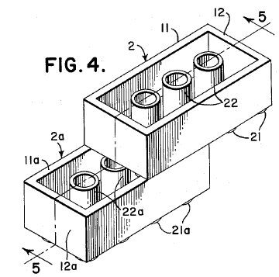
What do we want to translate?

Slide 17
Developmental toxicity, including dose-dependent delayed foetal ossification and possible teratogenic effects, were observed in rats at doses resulting in subtherapeutic exposures (based on AUC) and in rabbits at doses resulting in exposures 3 and 11 times the mean steady-state AUC at the maximum recommended clinical dose.
Notes:
Sentence from:
http://opus.nlpl.eu/EMEA.php

Slide 18
The films coated therewith, in particular polycarbonate films coated therewith, have improved properties with regard to scratch resistance, solvent resistance, and reduced oiling effect, said films thus being especially suitable for use in producing plastic parts in film insert molding methods.
Notes:
Sentence from: WIPO

Slide 19



General Domain Data
Notes:
Basically whatever we can find! not a lot of parallel text is produced
Biggest sources are EU parliament, UN

Slide 20
General Domain Data
Would it not be beneficial, in the short term, following the Rotterdam model, to inspect according to a points system in which, for example, account is taken of the ship's age, whether it is single or double-hulled or whether it sails under a flag of convenience.
Notes:
Sentence from:
Europarl German-English
http://www.statmt.org/europarl/

Slide 21
General Domain Data
Mama always said there's an awful lot you can tell about a person by their shoes.
Notes:
Sentence from:
http://www.opensubtitles.org/
(via opus)

Slide 22
Domain Mismatch
Notes:
data we want to translate differs from the vast majority of training data

Slide 23
Translating Russian Patents
Notes:
Case study

Slide 24
General Domain NMT
General Domain
NMT Model
50m General Domain
sentence pairs
Notes:
subtitles, UN, etc

Slide 25
General Domain NMT
Errors due to domain mismatch
General Domain
NMT Model
дверной замок повышенной степени защищенности от взлома Human: door lock with increased degree of security against burglary
System: door security door security door

Slide 26
In-Domain NMT
In-Domain
NMT Model
30k In-Domain
sentence pairs
Notes:
1000x smaller

Slide 27
In-Domain NMT
Errors due to lack of data
In-Domain
NMT Model
дверной замок повышенной степени защищенности от взлома Human: door lock with increased degree of security against burglary
System: door lock for a high degree of protection against coke

Slide 28
Domain Adaptation
Notes:
data we want to translate differs from the vast majority of training data

Slide 29
Continued Training
General Domain
NMT
Model
Continued Training
NMT
Model
30k In-domain
sentence pairs
50m General Domain
sentence pairs
Notes:
ct model in purple has seen both the in and general domain data

Slide 30
Continued Training
Improved
performance!
General Domain
NMT
Model
Continued Training
NMT
Model
30k In-domain
sentence pairs
дверной замок повышенной степени защищенности от взлома Human: door lock with increased degree of security against burglary
System: door lock with increased penetration protection

Slide 31

Russian → English Patents
+ 9.3
BLEU
Notes:
BLEU
standard metric in MT
higher better
counts how many words or phrases you got right compared to a reference
1000x less data is better when it is better data

Slide 32
Overview
Review of Neural Machine Translation (NMT)
Review of Domain Adaptation
Improving Domain Adaptation
Regularized Training Objective for Continued Training for Domain Adaptation in Neural Machine Translation [Khayrallah, Thompson, Duh & Koehn 2018]
Analysis of Noisy Corpora
On the Impact of Various Types of Noise on Neural Machine Translation [Khayrallah & Koehn 2018]

Slide 33
Regularized Training Objective for Continued Training for Domain Adaptation in Neural Machine Translation
Huda Khayrallah, Brian Thompson,
Kevin Duh & Philipp Koehn
WNMT at ACL 2018
Notes:
This work is based on this paper:
https://aclweb.org/anthology/W18-2705
(bibtex: https://aclweb.org/anthology/W18-2705)

Slide 34
Continued Training
General Domain
NMT
Model
Continued Training
NMT
Model
30k In-domain
sentence pairs

Slide 35
Regularized Continued Training
General Domain
NMT
Model
Regularized
Continued Training
NMT
Model
30k In-domain
sentence pairs
General Domain
NMT
Model
Notes:
We don’t want the CT model to move too far away from the GD

Slide 36
Teacher/Student Models
Word Level Knowledge distillation
Often used to make smaller/faster models
Train one model; use it to ‘teach’ another

Slide 37
Regularized Continued Training
Student
General Domain
NMT
Model
Regularized
Continued Training
NMT
Model
Teacher
General Domain
NMT
Model
Notes:
We don’t want the CT model to move too far away from the GD

Slide 38
NMT loss function
Gold Target
CT Model output
Cross Entropy( , )
Gold Target
CT Model output

Slide 39
Teacher/Student Loss Function
General Model Output
(teacher)
CT Model output
(student)
Cross Entropy( , )
General Model Output
(teacher)
CT Model output
(student)
Notes:
Here, we are training on in domain data

Slide 40
This work: Combine Both
(1 - 𝛼) × ( ) +
𝛼 × ( )
(1 - 𝛼) × Cross Ent ( , ) +
𝛼 × Cross Ent ( , )
Notes:
alpha is small here,
could be bigger, that would give us the full tradeoff curve

Slide 41
Results

Slide 42
Russian → English Patents
+ 1.2
BLEU

Slide 43
English → German Medical
+ 1.5
BLEU

Slide 44
Analysis

Slide 45
Russian → English General (patents)
- 9.2
BLEU
- 18.2
Notes:
What happens when we take the model that was adapted to do well on patents, and evaluate on the original domain
(bad things. Very bad things happen)

Slide 46
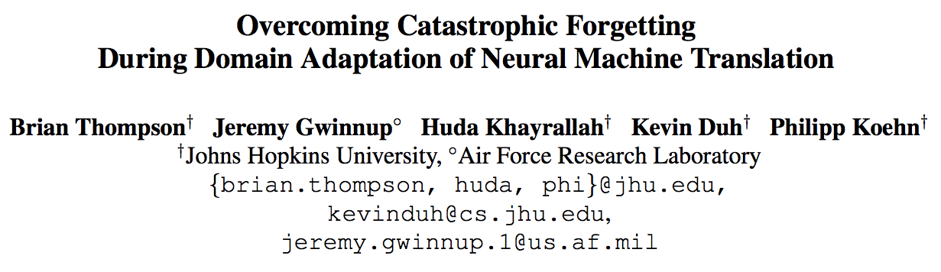
NAACL 2019
Notes:
We have other work to be presented at NAACL that focuses on the problem of forgetting in the original domain (as opposed to trying to improve in-domain performance)

Slide 47
Overview
Review of Neural Machine Translation (NMT)
Review of Domain Adaptation
Improving Domain Adaptation
Regularized Training Objective for Continued Training for Domain Adaptation in Neural Machine Translation [Khayrallah, Thompson, Duh & Koehn 2018]
Analysis of Noisy Corpora
On the Impact of Various Types of Noise on Neural Machine Translation [Khayrallah & Koehn 2018]

Slide 48
On the Impact of Various Types of Noise on Neural Machine Translation
Huda Khayrallah & Philipp Koehn
WNMT at ACL 2018 [Outstanding Contribution Award]
Notes:
This work is based on this paper:
https://aclweb.org/anthology/W18-2709
(bibtex: https://aclweb.org/anthology/W18-2709.bib)

Slide 49
More data is better!
BLEU
[Koehn & Knowles 2017]
Statistical MT with big LM
Statistical MT (SMT)
Neural MT (NMT)
Corpus size (English words)
Notes:
This plot is for English-> Spanish Tranlsation

Slide 50

Let’s go get more data!
Notes:
focus on web-crawled data in this talk
Primarily EU funded so broad coverage of EU languages (including Low resource: eg. Irish, Maltese)
But also other languages: eg. Sinhala, Nepali,

Slide 51
De→En translation
 | NMT | SMT
WMT17 | 27.2 | 24.0
+ raw paracrawl | 17.3 (-9.9) | 25.2 (+1.2)
+ filtered paracrawl | 32.4 (+5.2) | 25.8 (+1.8)

Slide 52
Raw Paracrawl
NMT | SMT
Notes:
Columns: how much of the crawled data we added (compared to the amount of clean data)
Within each cell: delta plot—how much did performance go up or down.
SMT Blue
NMT green

Slide 53
Manual Analysis
Notes:
Short Segments <=2 1%
Short Segments 3 - 5 5%

Slide 54
Noise Types
Misaligned Sentences
Misordered words
Wrong Language
Untranslated Sentences
Short Segments
Notes:
Not practical to annotate all of paracawl for noise types (millions of lines)
We generate artificial noise in an attempt to mimic these situations to analyze how MT reacts to each
I’m going to go through them all one by one. In general, most impact NMT more than SMT, but one was catastrophic for NMT

Slide 55
Misaligned Sentences
Notes:
sentences that are not translation of each other, but ok on their own

Slide 56
Misaligned Sentences
Die Koalas sind süß
Die Kängurus springen
Der Koala ist weich
Das Känguru ist schnell
The koalas are cute
The kangaroos jump
The koala is soft
The kangaroo is fast

Slide 57
Misaligned Sentences
Die Koalas sind süß
Die Kängurus springen
Der Koala ist weich
Das Känguru ist schnell
The kangaroos jump
The koala is soft
The kangaroo is fast
The koalas are cute

Slide 58
Misaligned Sentences
NMT | SMT

Slide 59
Misordered Words
Notes:
product of machine translation, poor human translation

Slide 60
Misordered Words (source)
Die Koalas sind süß
Die Kängurus springen
Der Koala ist weich
Das Känguru ist schnell
The koalas are cute
The kangaroos jump
The koala is soft
The kangaroo is fast
Notes:
product of machine translation, poor human translation

Slide 61
Misordered Words (source)
Koalas Die sind süß
Kängurus springen Die
ist Der weich Koala
schnell Känguru ist Das
The koalas are cute
The kangaroos jump
The koala is soft
The kangaroo is fast

Slide 62
Misordered Words (source)
NMT | SMT

Slide 63
Misordered Words (target)
Die Koalas sind süß
Die Kängurus springen
Der Koala ist weich
Das Känguru ist schnell
The koalas are cute
The kangaroos jump
The koala is soft
The kangaroo is fast

Slide 64
Misordered Words (target)
Die Koalas sind süß
Die Kängurus springen
Der Koala ist weich
Das Känguru ist schnell
koalas cute are The
kangaroos The jump
is The soft koala
fast The is kangaroo

Slide 65
Misordered Words (target)
NMT | SMT
Notes:
Bad in Random ways
systematic noise may hurt worse

Slide 66
Wrong Language
Notes:
Language ID does not work well on single sentences

Slide 67
Wrong Language (French source)
Die Koalas sind süß
Die Kängurus springen
Der Koala ist weich
Das Känguru ist schnell
The koalas are cute
The kangaroos jump
The koala is soft
The kangaroo is fast

Slide 68
Wrong Language (French source)
Les koalas sont mignons
Les kangourous sautent
Le koala est doux
Le kangourou est rapide
The koalas are cute
The kangaroos jump
The koala is soft
The kangaroo is fast

Slide 69
Wrong Language (French source)
NMT | SMT
Notes:
Multilingual MT works

Slide 70
Wrong Language (French target)
Die Koalas sind süß
Die Kängurus springen
Der Koala ist weich
Das Känguru ist schnell
The koalas are cute
The kangaroos jump
The koala is soft
The kangaroo is fast

Slide 71
Wrong Language (French target)
Die Koalas sind süß
Die Kängurus springen
Der Koala ist weich
Das Känguru ist schnell
Les koalas sont mignons
Les kangourous sautent
Le koala est doux
Le kangourou est rapide

Slide 72
Wrong Language (French target)
NMT | SMT
Notes:
We should have been in the wrong language half the time…
This didn’t hurt as much as we expected – perhaps because there was a domain shift between the two different corpora
systems picking up on the domain shift
Each sentence is output either all in French or all in English, not lots of mixing of languages

Slide 73
Untranslated

Slide 74
Untranslated (English Source)
Die Koalas sind süß
Die Kängurus springen
Der Koala ist weich
Das Känguru ist schnell
The koalas are cute
The kangaroos jump
The koala is soft
The kangaroo is fast

Slide 75
Untranslated (English source)
The koalas are cute
The kangaroos jump
The koala is soft
The kangaroo is fast
The koalas are cute
The kangaroos jump
The koala is soft
The kangaroo is fast

Slide 76
Untranslated (English source)
NMT | SMT
Notes:
We created a multi task system
copy & translate
When it sees English: it copies
When it sees German: it translates to English

Slide 77
Untranslated (German target)
Die Koalas sind süß
Die Kängurus springen
Der Koala ist weich
Das Känguru ist schnell
The koalas are cute
The kangaroos jump
The koala is soft
The kangaroo is fast

Slide 78
Untranslated (German target)
Die Koalas sind süß
Die Kängurus springen
Der Koala ist weich
Das Känguru ist schnell
Die Koalas sind süß
Die Kängurus springen
Der Koala ist weich
Das Känguru ist schnell

Slide 79
Untranslated (German target)
NMT | SMT
Notes:
learns to copy
3.2 BLEU basically gets the punctuation right

Slide 80
Short Segments
Notes:
<=2
3-5
specialized term lists/lexicons/etc
Practical in low resource
Recently some papers have come out on dictionary training in NMT,
but prior to that there had been concern about this affecting the LM component of NMT

Slide 81
Short Segments
Die
süß
Känguru
schnell
The
cute
Kangaroo
fast

Slide 82
Short Segments
≤ 2 words
3-5 words
Notes:
<=2
3-5
takeaway: goodness depends on how well matched the words are

Slide 83
Notes:
We seem to be ok with random noise, systematic noise is bad

Slide 84
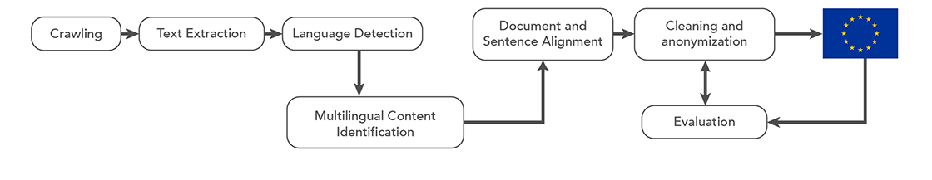
Filtering methods
BiCleaner [Espla-Gomis & Forcada 2009]
Zipporah [Xu & Koehn 2017]
WMT shared task [Koehn, Khayrallah, Heafield & Forcada 2018]
Dual Conditional Cross-Entropy Filtering [Junczys-Dowmunt 2018]
Zipporah [Khayrallah, Xu & Koehn 2018]
Notes:
Paracrawl is high recall
The practical option for people who want to use paracawrl is to use a filtered version
but we want to see what kind of noise exists to improve filtering methods
We not only want to know what kinds of data exists in the data, but also what kind of noise leads to poor perfromacne.
We organized a shared task on this topic, which attracted a variety of submissions, including a new state of the art method that was used to win the WMT shared task on translation -- [Junczys-Dowmunt 2018] from microsoft.

Slide 85
Overview
Review of Neural Machine Translation (NMT)
Review of Domain Adaptation
Improving Domain Adaptation
Regularized Training Objective for Continued Training for Domain Adaptation in Neural Machine Translation [Khayrallah, Thompson, Duh & Koehn 2018]
Analysis of Noisy Corpora
On the Impact of Various Types of Noise on Neural Machine Translation [Khayrallah & Koehn 2018]

Slide 86
Questions?

